Slide 1
CPD shifts of August 2021
Justin mentioned these shifts look like they’re related to the change in toxgl (long channel pfet) Booleans

Slide 2
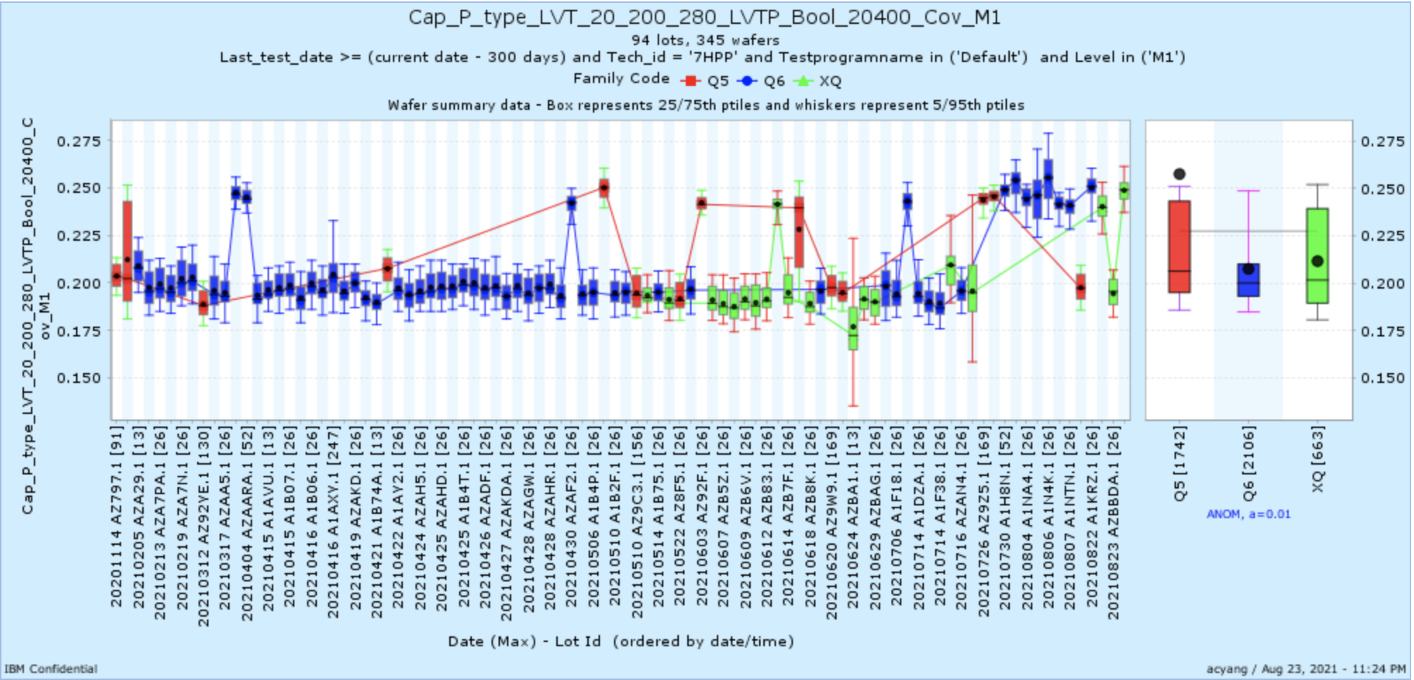
Device – 8/3/2021

Slide 3
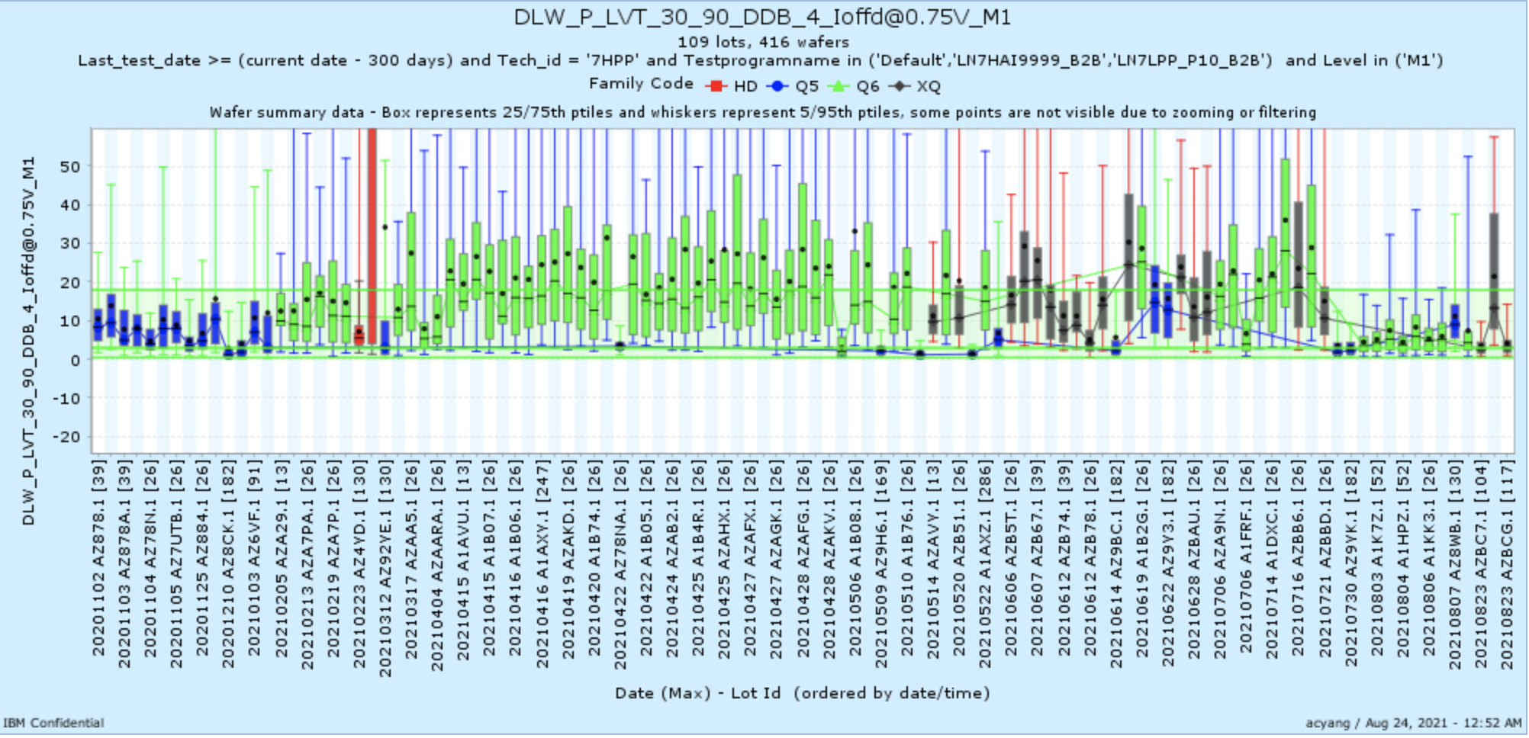
Device 7/30/2021

Slide 4
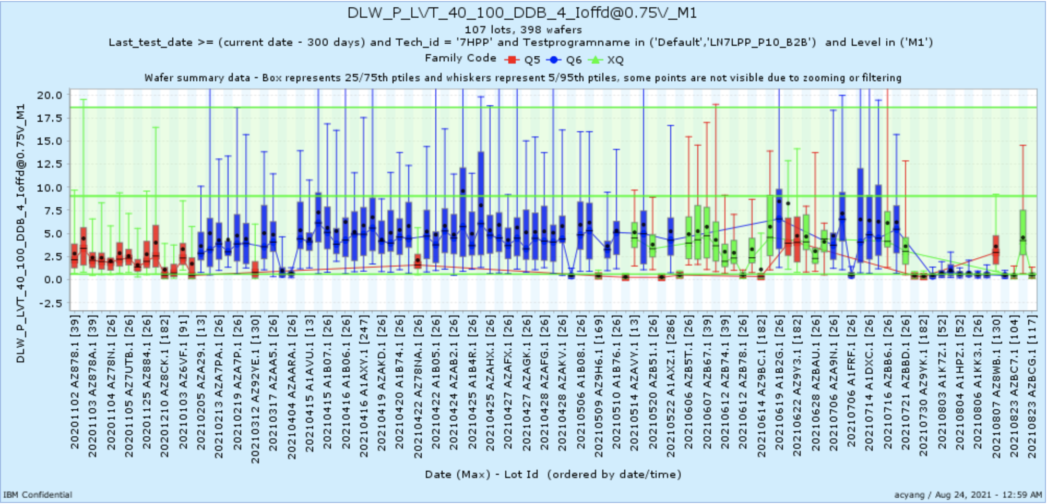
Device 7/30/2021

Slide 5
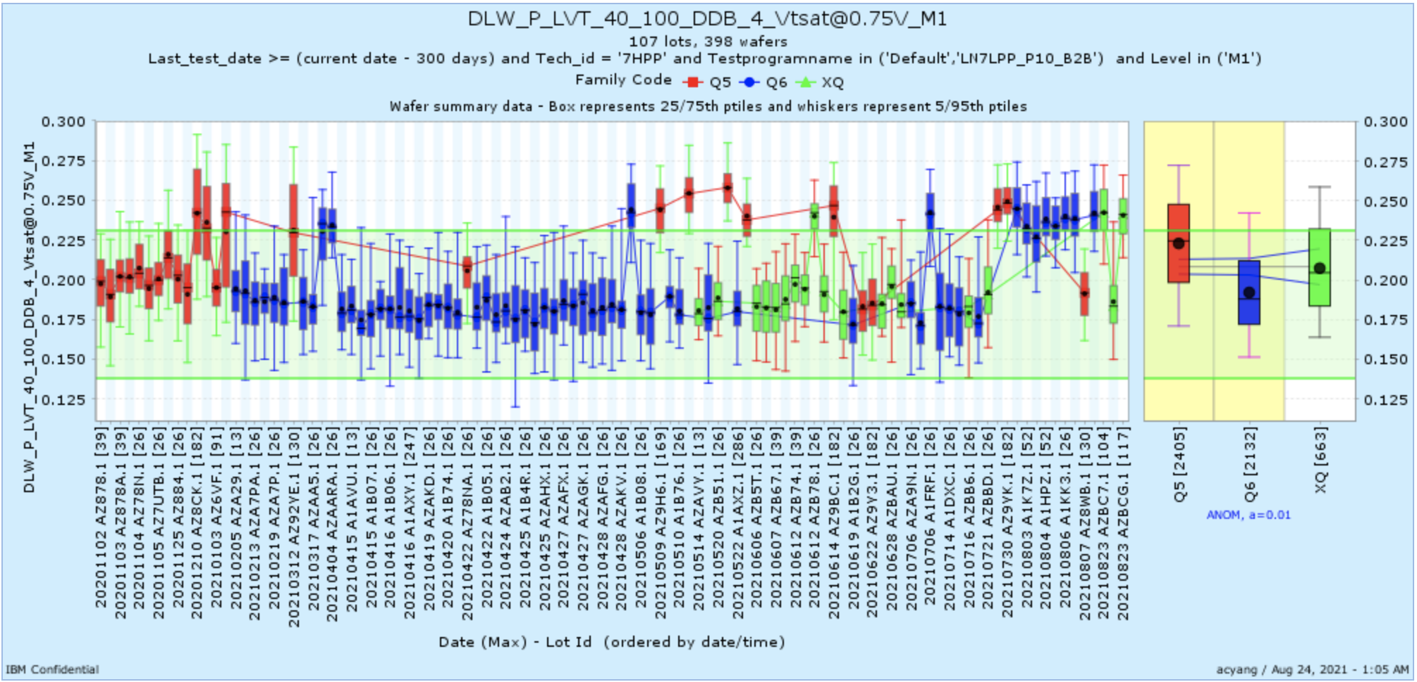
Device 7/30/2021

